Slide 1
Naïve Bayes Classifier Outline
Background
Probability Basics
Probabilistic Classification
Naïve Bayes
Example: Play Tennis
Relevant Issues
Conclusions

Slide 2
Background
There are three methods to establish a classifier
a) Model a classification rule directly
Examples: k-NN, decision trees, perceptron, SVM
b) Model the probability of class memberships given input data
Example: multi-layered perceptron with the cross-entropy cost
c) Make a probabilistic model of data within each class
Examples: naive Bayes, model based classifiers
a) and b) are examples of discriminative classification
c) is an example of generative classification
b) and c) are both examples of probabilistic classification

Slide 3
Probability Basics
Prior, conditional and joint probability
Prior probability:
Conditional probability:
Joint probability:
Relationship:
Independence:
Bayesian Rule

Slide 4
Example by Dieter Fox

Slide 5
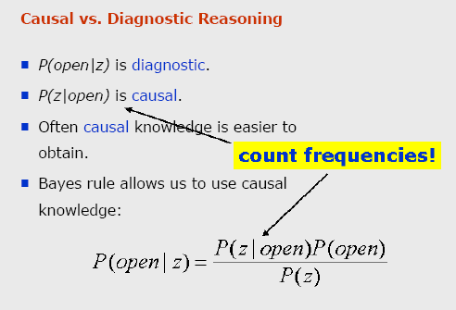

Slide 6
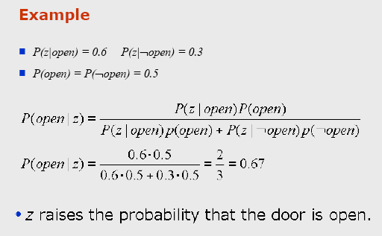

Slide 7
Probabilistic Classification
Establishing a probabilistic model for classification
Discriminative model
Generative model
MAP classification rule
MAP: Maximum A Posterior
Assign x to c* if
Generative classification with the MAP rule
Apply Bayesian rule to convert:

Slide 8
Feature Histograms
P(x)
C₁
C₂
x
Slide by Stephen Marsland

Slide 9
Posterior Probability
P(C|x)
1
0
x
Slide by Stephen Marsland

Slide 10
Naïve Bayes
Bayes classification
Difficulty: learning the joint probability
Naïve Bayes classification
Making the assumption that all input attributes are independent
MAP classification rule

Slide 11
Naïve Bayes
Naïve Bayes Algorithm (for discrete input attributes)
Learning Phase: Given a training set S,
Output: conditional probability tables; for elements
Test Phase: Given an unknown instance ,
Look up tables to assign the label c* to X’ if

Slide 12
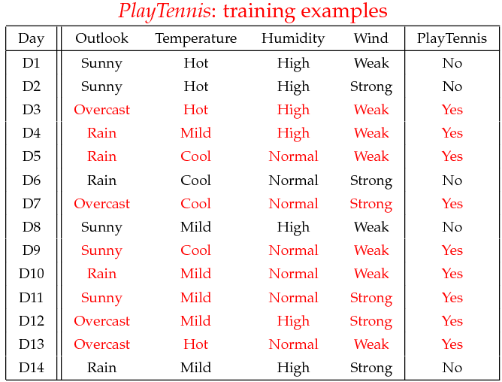
Example
Example: Play Tennis

Slide 13
Example
Learning Phase
Outlook | Play=Yes | Play=No
Sunny | 2/9 | 3/5
Overcast | 4/9 | 0/5
Rain | 3/9 | 2/5
Temperature | Play=Yes | Play=No
Hot | 2/9 | 2/5
Mild | 4/9 | 2/5
Cool | 3/9 | 1/5
Humidity | Play=Yes | Play=No
High | 3/9 | 4/5
Normal | 6/9 | 1/5
Wind | Play=Yes | Play=No
Strong | 3/9 | 3/5
Weak | 6/9 | 2/5
P(Play=Yes) = 9/14
P(Play=No) = 5/14

Slide 14
Example
Test Phase
Given a new instance,
x’=(Outlook=Sunny, Temperature=Cool, Humidity=High, Wind=Strong)
Look up tables
MAP rule
P(Outlook=Sunny|Play=Yes) = 2/9
P(Temperature=Cool|Play=Yes) = 3/9
P(Huminity=High|Play=Yes) = 3/9
P(Wind=Strong|Play=Yes) = 3/9
P(Play=Yes) = 9/14
P(Outlook=Sunny|Play=No) = 3/5
P(Temperature=Cool|Play==No) = 1/5
P(Huminity=High|Play=No) = 4/5
P(Wind=Strong|Play=No) = 3/5
P(Play=No) = 5/14
P(Yes|x’): [P(Sunny|Yes)P(Cool|Yes)P(High|Yes)P(Strong|Yes)]P(Play=Yes) = 0.0053
P(No|x’): [P(Sunny|No) P(Cool|No)P(High|No)P(Strong|No)]P(Play=No) = 0.0206
Given the fact P(Yes|x’) < P(No|x’), we label x’ to be “No”.

Slide 15
Relevant Issues
Violation of Independence Assumption
For many real world tasks,
Nevertheless, naïve Bayes works surprisingly well anyway!
Zero conditional probability Problem
If no example contains the attribute value
In this circumstance, during test
For a remedy, conditional probabilities estimated with

Slide 16
Relevant Issues
Continuous-valued Input Attributes
Numberless values for an attribute
Conditional probability modeled with the normal distribution
Learning Phase:
Output: normal distributions and
Test Phase:
Calculate conditional probabilities with all the normal distributions
Apply the MAP rule to make a decision

Slide 17
Conclusions
Naïve Bayes based on the independence assumption
Training is very easy and fast; just requiring considering each attribute in each class separately
Test is straightforward; just looking up tables or calculating conditional probabilities with normal distributions
A popular generative model
Performance competitive to most of state-of-the-art classifiers even in presence of violating independence assumption
Many successful applications, e.g., spam mail filtering
Apart from classification, naïve Bayes can do more…

